Slide 1
My Brief introduction
By: UWIZEYE Delphine
Email:delywizy@gmail.com

Slide 2
CONTENTS
Republic of Rwanda
My former school
About myself

Slide 3

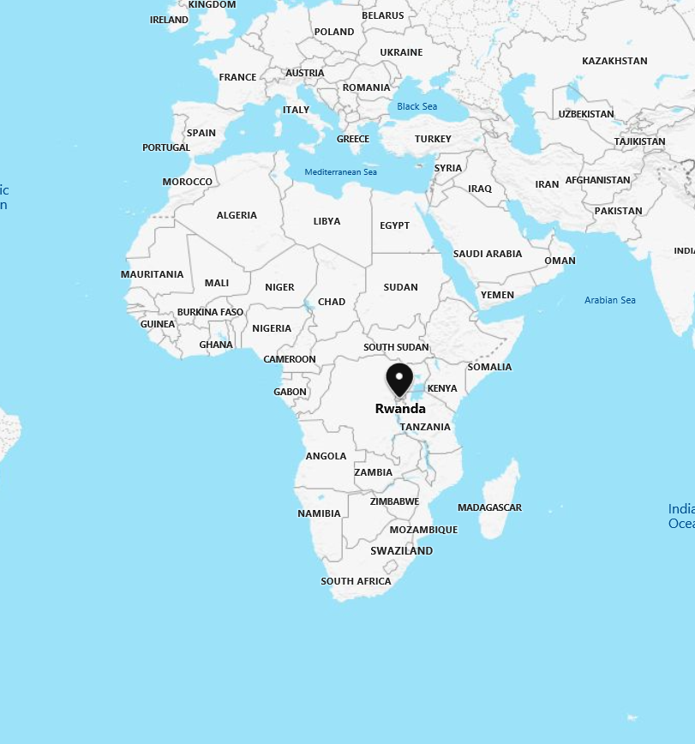
1.REPUBLIC OF RWANDA LOCATION
The Republic of Rwanda, is a country in Central and East Africa Located in few degrees south of the Equator. Rwanda is bordered by Uganda, Tanzania, Burundi, and the Democratic Republic of the Congo. Rwanda is in the African Great Lakes region. Its geography is dominated by mountains in the west and savanna to the east, with numerous lakes throughout the country.

Slide 4
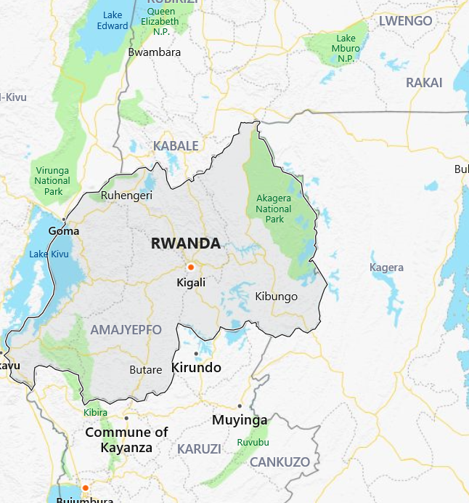
REPUBLIC OF RWANDA cont'
General description
Our president: Paul KAGAME
The capital of RWANDA is Kigali.
Area:10,169 sq miles (26337.5891sq. km)
population:12.21 million (2017)
Official languages: kinyarwanda
English
French
Kiswahili.
Rwandan currency: Rwandan francs(RWF) 1KRW=0.77RWF
Calling code:250
Time zone: GMT + 2h

Slide 5


General description cont'
It has 2 rainy seasons: February to April and October to December.
Average temperature (20-30ºc)
Our flag Our seal

Slide 6
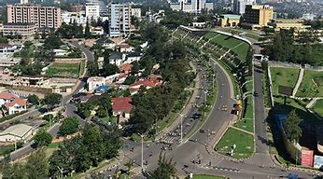
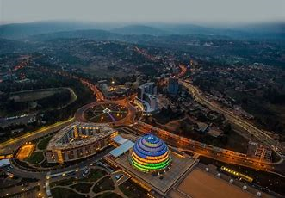
KIGALI the capital of RWANDA
-Biggest and most overpopulated city. -The cleanest city in Rwanda. -It hosts the main residence and offices of the President
and all government ministries

Slide 7
2.MY FORMER SCHOOL
Rwanda has only one public University which has a head office in Kigali city.
It is composed by 6 colleges located in different cities.
College of Science and Technology
College of Arts and Social Sciences
College of Business and Economics
College of Education
College of Medicine and Health Sciences
College of Agriculture and Veterinary Medicine.

Slide 8
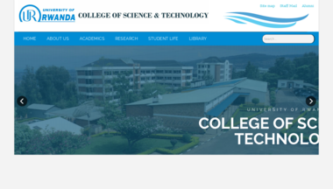
College of science and technology(CST)
It is in Kigali city exactly in Nyarugenge
district
CST's principal is Dr Ignace GATARE.

Slide 9
CST cont'
CST is divided into schools,
schools into departments,
and departments into programs
CST
School of mining and gelogy
School of architecture and built environment
School of science
School of ICT
School of engineering
Computer science
Information systems
Computer and software engineering
Inforamtion technology
Electrical and electronics engineering
Surveying and geomatics engineering
Mechanical engineering
Electrical power engineering
Civil engineering
Electronics and telecommunication engineering

Slide 10
Electronics and telecommunication engineering
About studies in University of rwanda, also we studied 2 semesters in each year. And most of bachelor's programs was for 4 years.
During my studies, also I spent 4 years in university and I have covered many modules.
During studies, lecturers tried to give us enough slides so that no more books will be required because it was so difficult to each student to get a book.
There was many courses that required many practices in the lab, that it was impossible to get all the access needed to practice those courses because labs are very few and not well equipped. That's why we didn’t gain the experience we supposed to gain in university.

Slide 11
3. About Myself
Names: UWIZEYE Delphine
Birthdate: 16.02.1996
Marital status: married since 2 months
Hobby: watching movies
Strength: highly committed to meet my goals, always being on time.
Weaknesses: easily get tired , somehow shy.
I like living in peace with everyone.

